Slide 1
Assessing Data Quality and Predictive Bias in the Adult Income Dataset
COMP 331 — Final Project Presentation
Professor Amir Daneshpajouh
By Cameron Carnegie
Notes:
“Hi everyone, my name is Cameron Carnegie, and this is my COMP 331 final project, where I analyzed the Adult Income dataset to study data quality issues and how they affect predictive bias.”

Slide 2
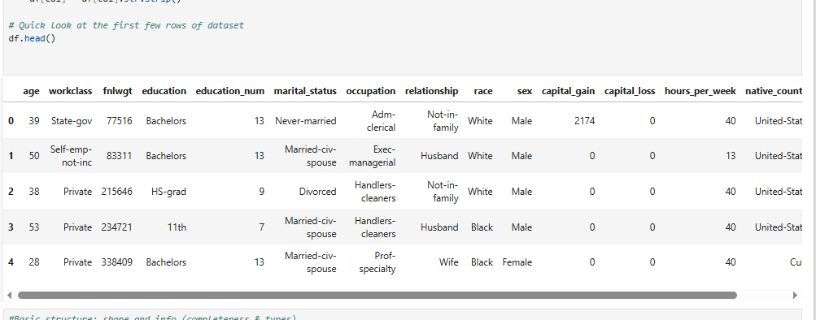
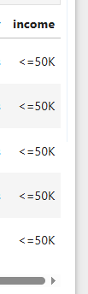
The Dataset
to see if income >50k or <=50k
14 features ….. ----------------------------------------------------->
32,561 rows
Note: once categorical features are one-hot encoded, its actually 96 features for the regression model (7 different marital statuses, 40+ countries, etc.)
Notes:
“The dataset I analyzed comes from the 1994 U.S. Census. It includes around 32,000 individuals and is commonly used for machine learning classification tasks. It’s useful for our course because it has several real-world data quality problems — missing values, duplicates, and a lot of demographic skew — which provides a realistic environment to study completeness, consistency, and bias.”

Slide 3
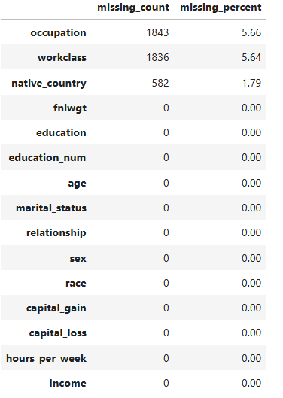
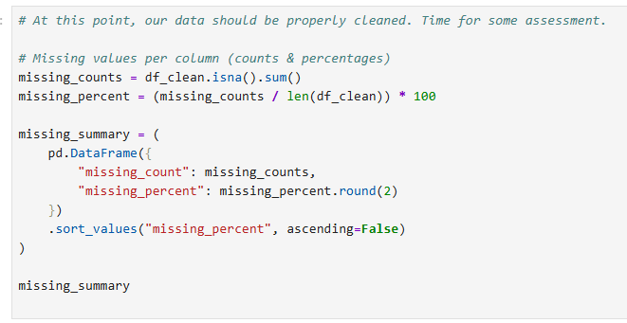
Data Quality Findings: Completeness
Find rows with missing data values
Missing data in 3 categories
Notes:
“When I profiled the dataset, I found missing values concentrated in only three features: occupation, workclass, and native_country. Together these accounted for around five percent missingness. Using the dataset’s ‘?’ placeholders, I converted those to NaN and removed the 24 duplicate rows. Because missingness in this dataset tends to correlate with variables like education and income, it weakens the model’s reliability for the groups most affected.”

Slide 4
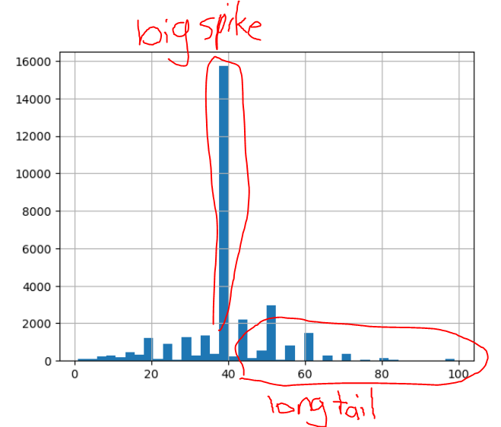
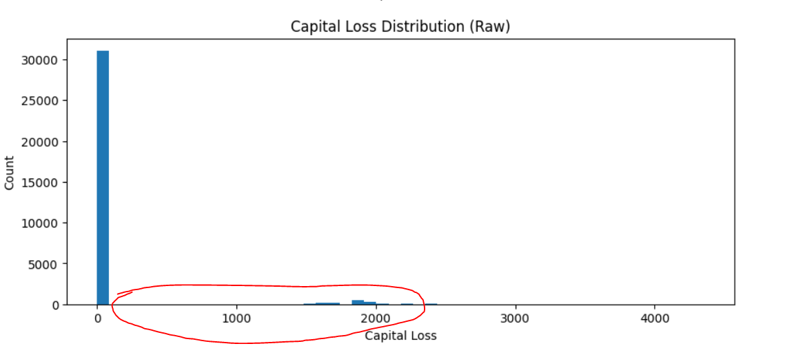
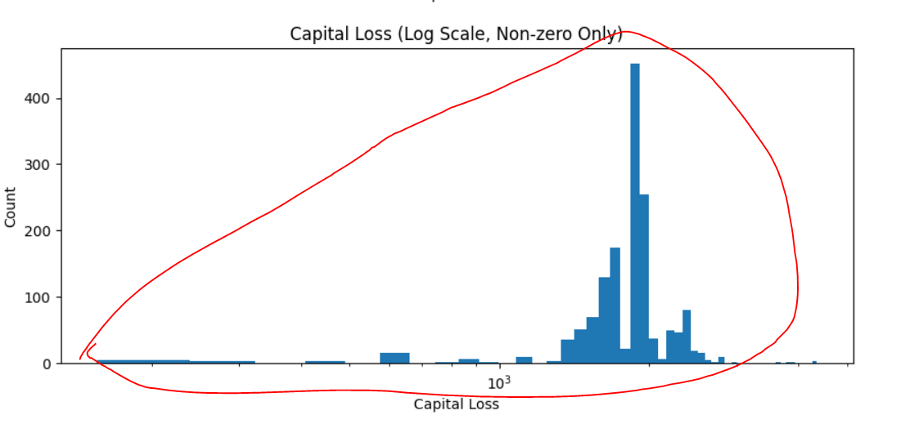
Data Quality Findings: Skew & Outliers
#
people
Capital loss = loss of $ from investments that went bad
# of hours worked
Super skewed!
Notes:
“The dataset is extremely skewed. Most respondents are White, male, and from the United States. Income is also heavily skewed: most earn below $50K. Hours per week shows a strong spike at 40, and capital gains/loss have over 90% zeros with a few extreme values up to 99,999. All of these skews make the model fit the majority group well but reduce accuracy for minority or low-frequency groups.”

Slide 5
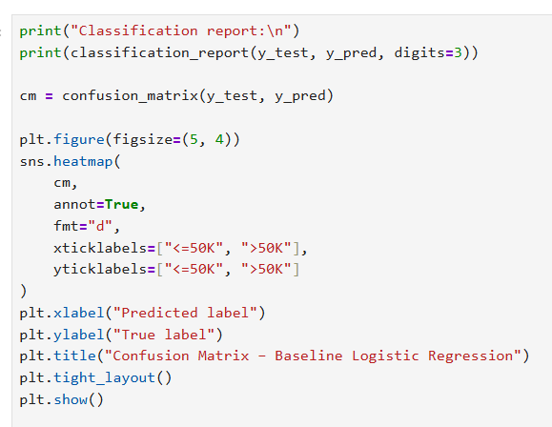
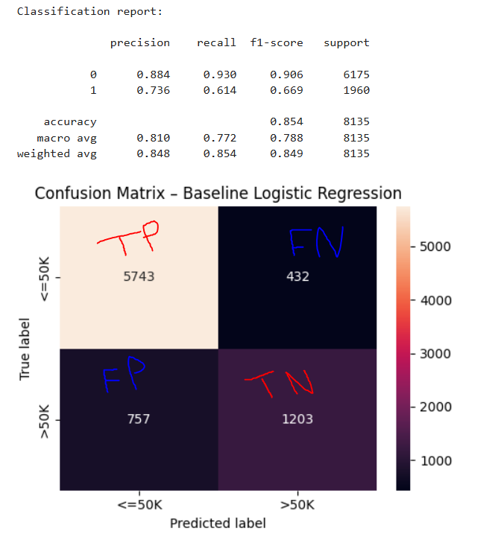
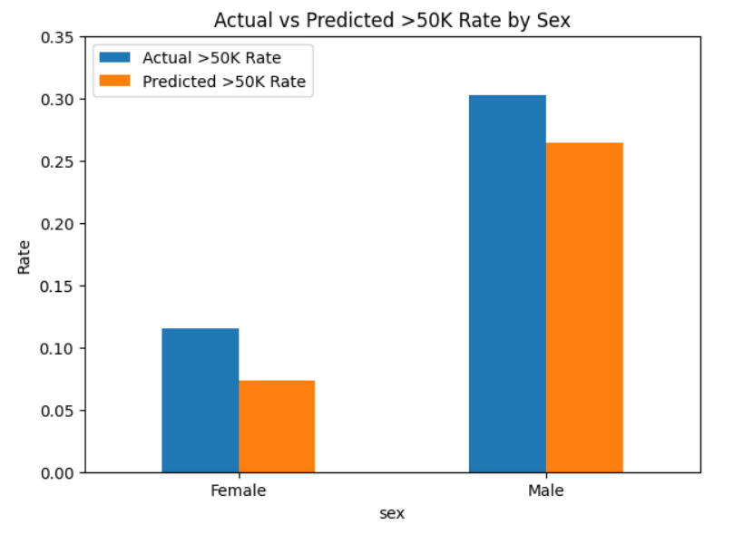
Model & Bias Results
Model worse at predicting >50K than <50k because data heavily skewed <50K. Also note large income disparity between male and female in data and model prediction
Visualizing the regression model
With a Confusion Matrix
accuracy
Notes:
“I trained a logistic regression model using one-hot encoding. The overall accuracy was around 85%, but performance varied strongly by subgroup. The model predicted high income for men far more often than for women — the Statistical Parity Difference was about 0.167, meaning men received high-income predictions 16.7% more frequently. Removing sex and race from the model barely changed accuracy, which suggests other features are acting as proxies for those attributes.”

Slide 6
Recommendations
Imputation → e.g MICE (predict missing values)
Rebalancing → SMOTE (over-sample underrepresented groups in data)
Outlier Handling → winsorization (reduce influence of extreme outliers)
Feature auditing → detect unintended proxy features (features that when combined encode things like gender or race, leading to unintended discrimination or bias in the model)

Slide 7
Conclusion
Bias + skew + missing data → unfair predictions
Notes:
“This project showed that data quality problems — especially skew, missingness, and demographic imbalance — directly affect model fairness. Even with an apparently good accuracy score, the model systematically mispredicts certain groups because the underlying data reflects societal inequalities. Good data quality analysis is essential before trusting machine learning predictions.”

